Slide 1
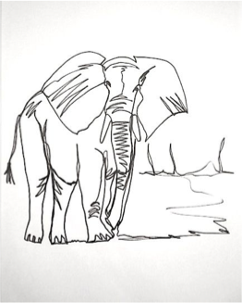
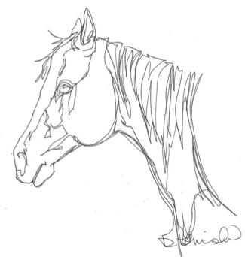
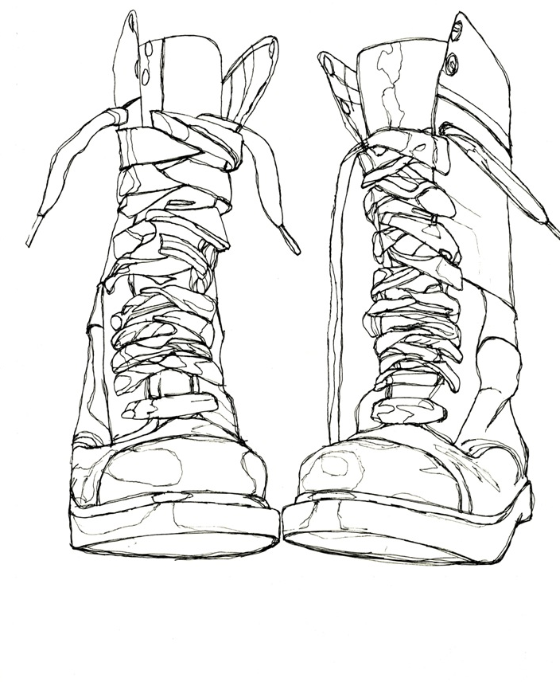
Contour drawing, is an artistic technique where you draw only the edges or outlines of the objects you see. There is no advanced shading.

Slide 2
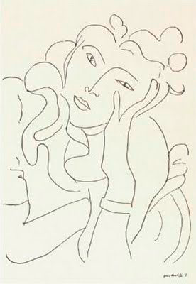
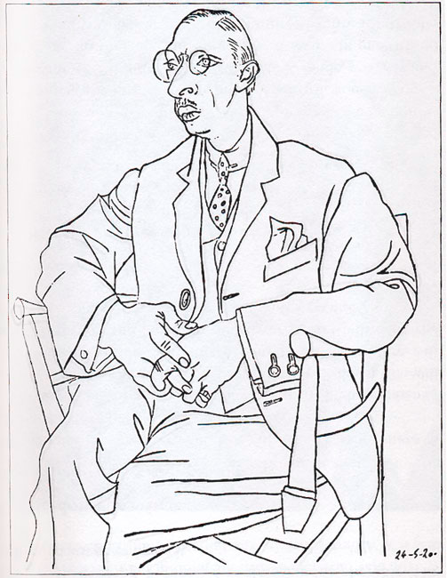
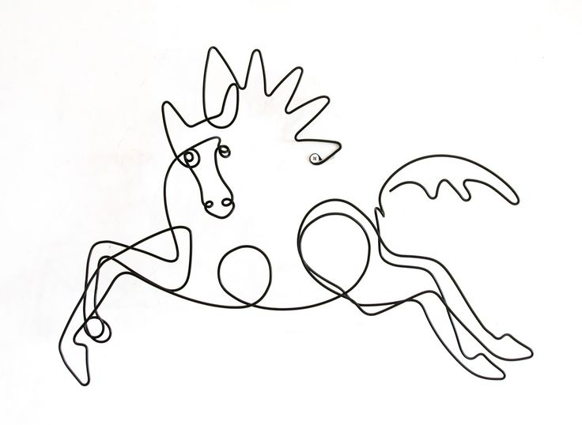
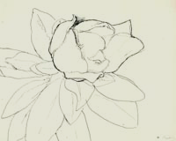
Henri Matisse
Picasso

Slide 3
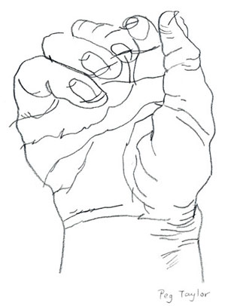
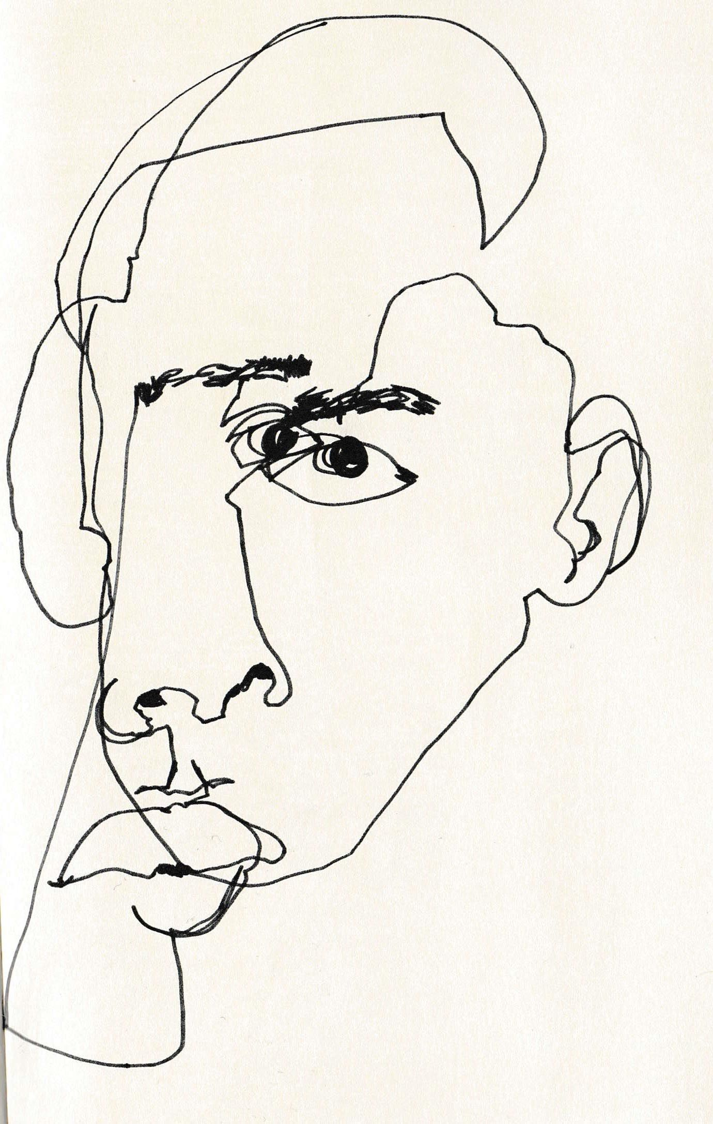
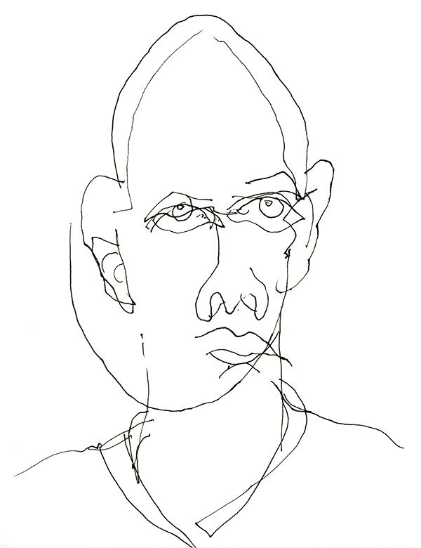
Blind contour drawing is where an artist draws the contour of a subject
without looking at the paper or picking up their pencil

Slide 4
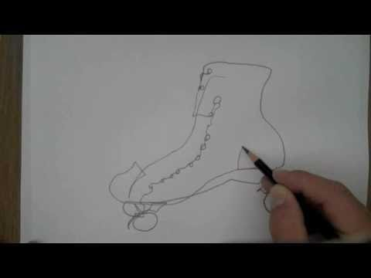

Slide 5
You will be practicing Blind Contour by drawing YOUR hands
Draw at least 4 DIFFERENT poses
Go slow, draw big and make A LOT of drawings!
DO NOT ERASE!

Slide 6
Continuous Line Contour
Draw while looking at your object and your paper
DO NOT pick up your pencil
It will be a Continuous line

Slide 7
Now you will practice Continuous Line Contour by drawing YOUR hands
Draw at least 4 poses
Go slow, draw big and make A LOT of drawings!
DO NOT ERASE!

Slide 8
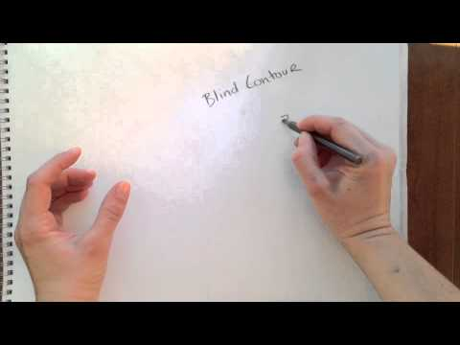

Slide 9
Pre-Test Question
What is Composition?
Interesting and balanced use of space
Use of negative space
Use of interesting space
A lot of contrast and value

Slide 10
Pre-Test Question
What is Composition?
Interesting and balanced use of space
Use of negative space
Use of interesting space
A lot of contrast and value

Slide 11
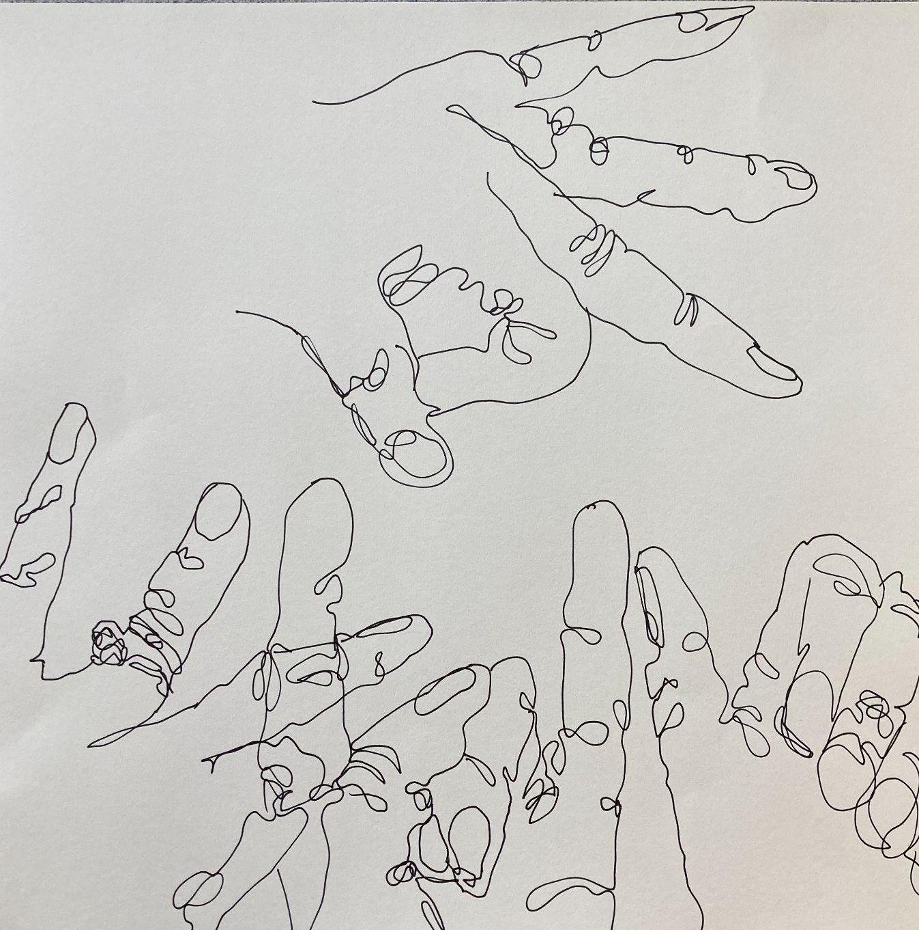
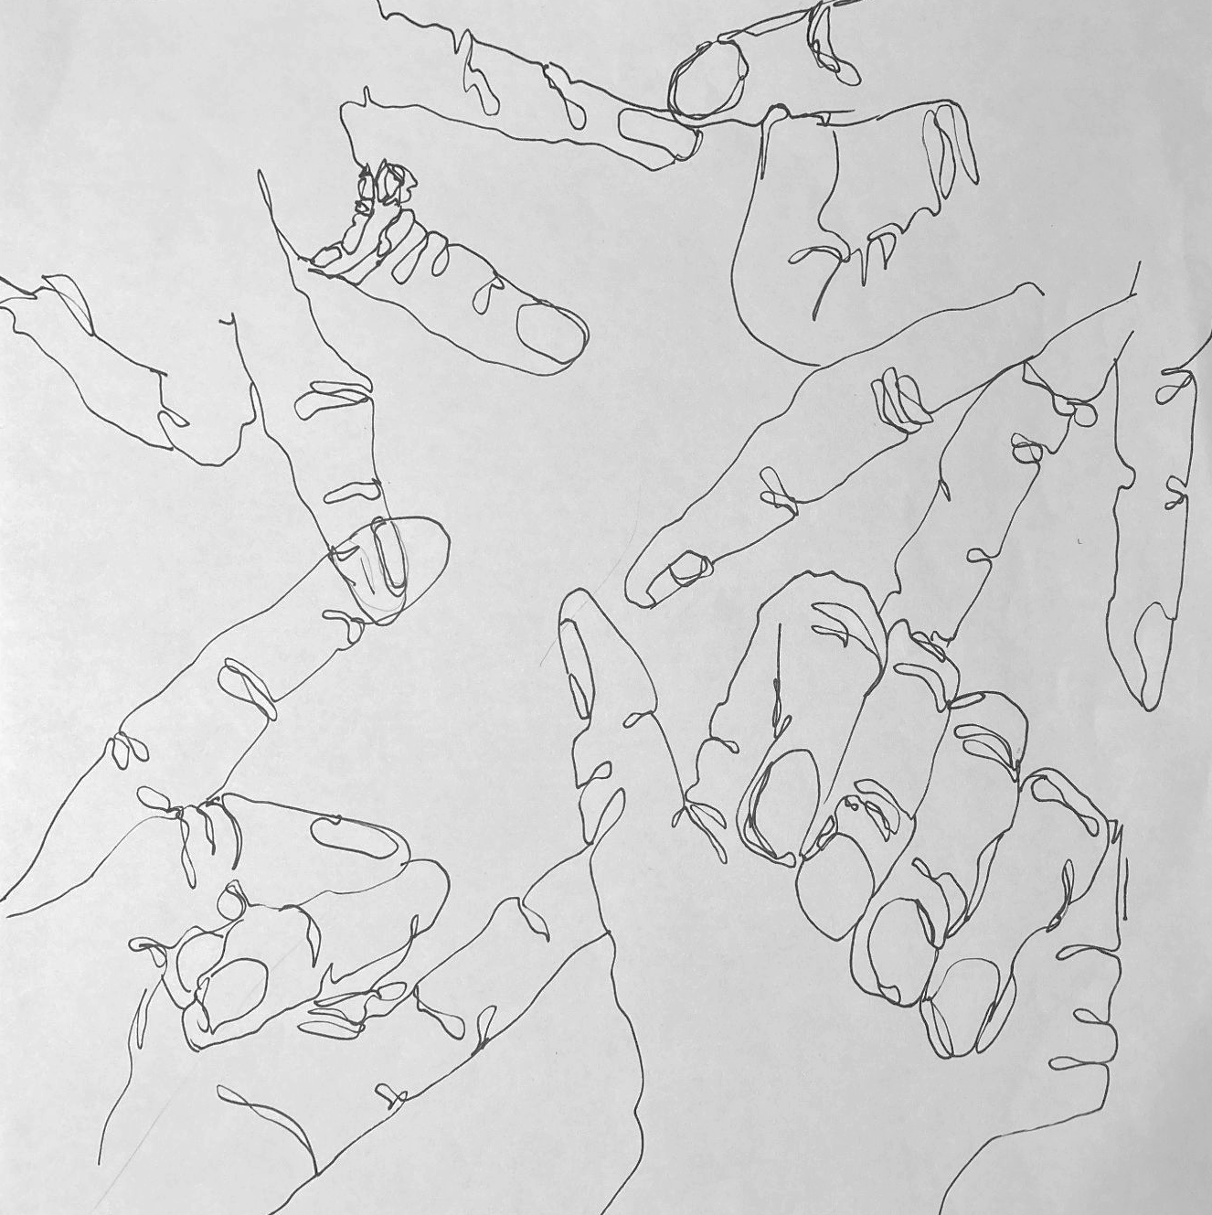
What do you notice about these 2 drawings?

Slide 12
TODAY:
Pick 4 of your favorite hand drawings
(5 if they are very small)
Draw more if you are not happy with your drawings
Transfer them to a white square paper
Create an interesting composition
No floating cut off hands
Hands MUST overlap in several spots
Hands should be drawn in thin black sharpie

